Slide 1
ITC PROJECT Image Compression using SVD
Primanshu (2K18/CO/261)
Prajjwal Chittori (2K18/CO/249)
Dept. of Computer Science and Engineering)

Slide 2
Agenda
To study and understand Image Compression and its applications.
We will discuss various aspects and steps involved in SVD and its utilization in image compression.
We will attempt to understand how the concept of SVD in image compression is implemented and how to maintain balance between compression and image quality.
Keyword – SVD ( Singular Value Decomposition )

Slide 3
Objectives
Reducing the size of an image and aiming to increase the capacity storage of media (limited in capacity). Images of lower size can be transmitted faster over the network.
The objective of image compression is to reduce the redundancy of the image and to store and transfer the data in efficient form.
The technique that we are going to use for the purpose of image compression is SVD which is known as singular value decomposition. We achieve compression by minimizing the number of bits to represent an image.

Slide 4

Redundancy Removal
Psycho Visual Redundancy
Inter Pixel redundancy
Coding redundancy
Redundancy due to similarities in neighboring pixels.
Happens when more bits are used to define image than required
Limitation of human eye to interpret fine details

Slide 5
SVD implementation
Applying SVD does not result in reduction of the image size rather it remains the same.
After applying SVD, We can take the first k values of these sorted(descending) singular values and the image quality is directly proportional to the value of k and inversely proportional to the compression quality.
The removal follows the property of removing only those values which contain the least information

Slide 6
Singular Value Decomposition
SVD is a linear matrix transformation used for compressing images. SVD stands of singular value decomposition.

Slide 7
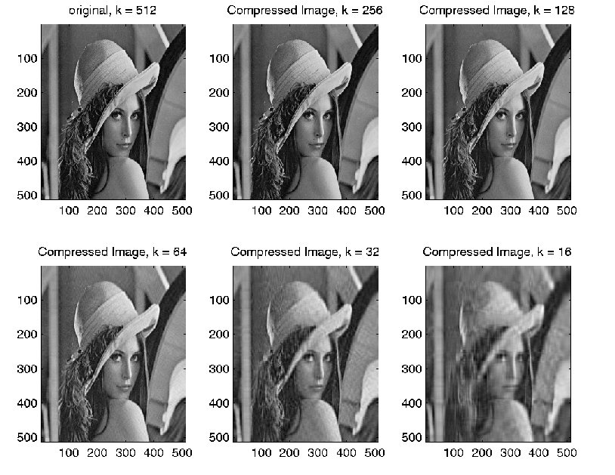

Slide 8
Steps
Splitting image
Redundancy removal
Analyzing ideal value of k
1
3
5
2
4
6
Analyzing redundancies
Applying
SVD
Generating compressed image

Slide 9
Methodology
The quality of the image compression is generally measured with PSNR(peak-signal-to-noise ratio) and SSIM(structural similarity index).
We aim to show weaknesses in these metrics and make use of energy ratio as a metric to evaluate the quality of image compression.
We aim to increase the compression ratio while minimizing the MSE as much as possible by introducing energy ratio.
Keywords – PSNR ( peak-signal-to-noise ratio )
SSIM ( structural similarity index )

Slide 10

SVD implementation
We can take the first k values of these sorted(descending) singular values and the image quality is directly proportional to the value of k and inversely proportional to the compression quality.
Mean Squared Error can also be calculated for the compressed images using the following relation-

Slide 11
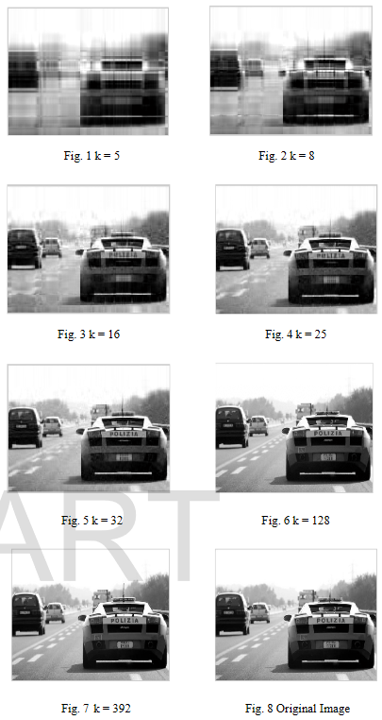
Images given here show the results of applying SVD on frames of video, taking different values of k

Slide 12
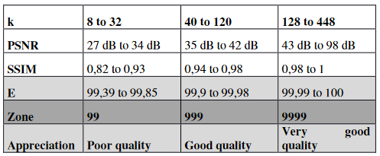
Insight on the average values of PSNR, SSIM and E

Slide 13
Analysis of Image quality
The image quality obtained for values of k in [ 8 , 32 ] is very poor.
The image quality is considerably better for the values of k in range [ 40 , 120 ].
We obtain very good quality for the values of k greater than 128.
The next figure will showcase the quality of image compressed different values of k

Slide 15
Conclusion
The given result leads to the conclusion that the advantage of SVD is it’s less computational complexity and good compression result.
The degree of compression required by models and applications can be achieved by adjusting the values of k.
This results in varying degrees of compression depending on the number of eigenvalues chosen.

Slide 16
APPLICATIONS
Approximation
Face Recognition
Image Compression
Watermarking

Slide 17

THANKS!

